Slide 1
CSA-0509 database Management system
Guided By :
Dr R Kesavan
Presented by :
A Mohammad Naheed (192525336)

Slide 2
Question 1: Create and Present an ER Diagram for an Online Library System
Introduction
ER stands for Entity Relationship.
ER Diagram is a graphical representation of a database.
It helps identify entities, attributes, and relationships.
It acts as a blueprint before database implementation.
It minimizes errors during database design.
It improves communication between developers and users.
It is widely used in Database Management Systems (DBMS).

Slide 3
What is an ER Diagram?
Definition
A conceptual model used to design databases.
Represents real-world objects and their relationships.
Developed before creating database tables.
Helps understand the overall database structure.
Main Components
Entity – A real-world object (Book, Member, Librarian).
Attribute – Characteristics of an entity (Book ID, Name).
Relationship – Connection between entities (Borrows, Issues).
Primary Key – Uniquely identifies each record.
Cardinality – Defines how entities are related (1:1, 1:M, M:N).

Slide 4
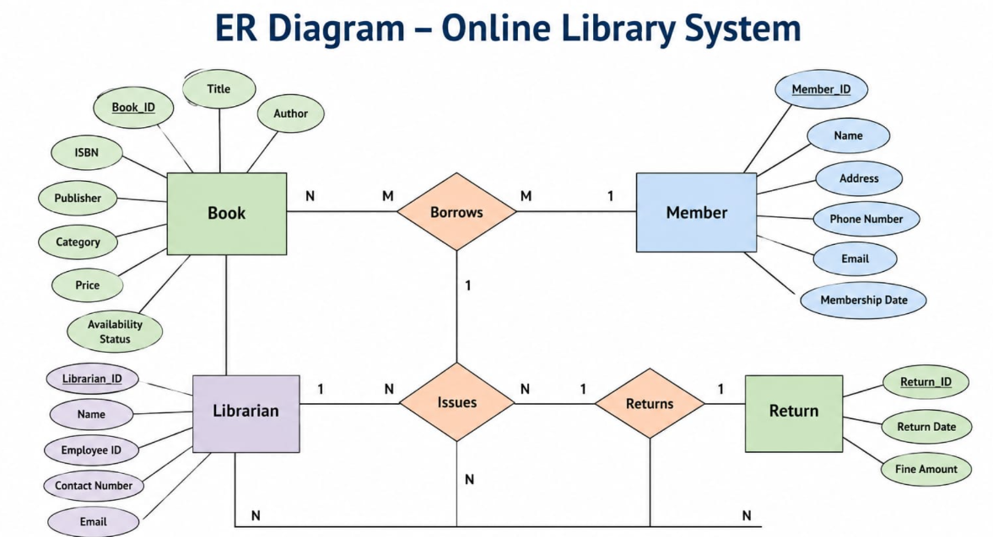
Advantages of ER Diagram
Provides a clear database structure.
Reduces duplicate data.
Improves data integrity.
Ensures consistency of information.
Simplifies database implementation.
Supports easy modification and maintenance.

Slide 5
Conclusion
ER Diagram is the foundation of database design.
It identifies entities, attributes, and relationships.
It helps build an efficient Online Library Management System.
It improves accuracy, consistency, and scalability.
It serves as the basis for creating relational databases.

Slide 6
Question 2: EER Model – Generalization and Specialization with a University Case Study
Introduction
EER stands for Enhanced Entity Relationship Model.
It is an extension of the basic ER model.
It provides advanced features for database modeling.
It supports inheritance concepts through generalization and specialization.
It represents complex real-world scenarios more effectively.
It improves database flexibility and scalability.

Slide 7
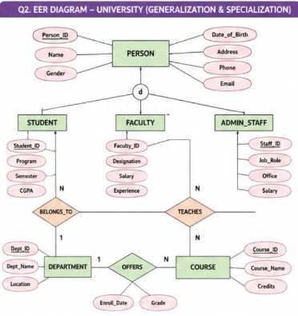
What is an EER Model?
Definition
An advanced version of the ER model.
Includes all ER model concepts along with additional features.
Models complex relationships more accurately.
Supports inheritance between entities.
Features of EER Model
Generalization
Specialization
Inheritance
Superclass and Subclass
Aggregation
Categorization

Slide 8
Advantages of EER Model
Models complex databases accurately.
Supports inheritance of common attributes.
Reduces data redundancy.
Improves database consistency.
Makes database maintenance easier.

Slide 9
Conclusion
EER is an advanced version of the ER model.
Generalization combines similar entities into a superclass.
Specialization divides a superclass into specialized subclasses.
The University case study demonstrates efficient organization of students, faculty, and staff.
EER models improve database design, flexibility, and maintainability.

Slide 10
Question 3: Data Independence (Logical and Physical) and its Significance in DBMS Architecture
Introduction
Data Independence is a key feature of Database Management Systems (DBMS).
It allows changes at one level of the database without affecting other levels.
It separates the database structure from application programs.
It makes databases flexible and easier to maintain.
It reduces the cost of database modifications.

Slide 11
What is Data Independence?
Definition
Data Independence is the ability to modify the database schema without changing application programs.
It enables changes in database design while keeping user applications unaffected.
It ensures smooth database maintenance and upgrades.
Need for Data Independence
Supports database growth.
Simplifies maintenance.
Improves flexibility.
Reduces development time.

Slide 12
Significance of Data Independence
Importance
Reduces maintenance effort.
Improves database flexibility.
Enhances data security.
Supports database scalability.
Increases application stability.
Real-World Applications
Banking Systems
Hospital Management Systems
University Databases
E-Commerce Websites
Airline Reservation Systems

Slide 13
CONCLUSION
Data Independence allows changes in one level without affecting other levels.
It is divided into Physical Data Independence and Logical Data Independence.
The three-schema architecture helps achieve data independence.
It improves flexibility, performance, security, and maintainability.
It is one of the most important features of modern DBMS.

Slide 14
Question 4: Software Components of a DBMS (Query Processor, Storage Manager, and Transaction Manager)
Introduction
A Database Management System (DBMS) is software used to create, manage, and retrieve data efficiently.
It consists of several software components that work together.
These components process queries, manage storage, and ensure reliable transactions.
They improve the performance, security, and consistency of the database.
The three main software components are:
Query Processor
Storage Manager
Transaction Manager

Slide 15
Overview of DBMS Software Components
Major Components
Query Processor – Interprets and executes SQL queries.
Storage Manager – Manages physical storage and retrieval of data.
Transaction Manager – Ensures safe and reliable execution of transactions.
These components work together to provide efficient database operations.
They help maintain data integrity, security, and performance.
Workflow
User → SQL Query → Query Processor → Storage Manager → Database → Transaction Manager → Result

Slide 16
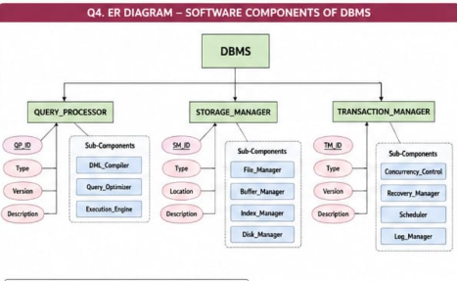
Importance of DBMS Software Components
Enables fast query processing.
Provides secure and efficient data storage.
Ensures reliable transaction processing.
Maintains data consistency and integrity.
Supports multiple users simultaneously.
Applications
Banking Systems
Hospital Management Systems
Airline Reservation Systems
E-Commerce Platforms
University Management Systems
Library Management Systems

Slide 17
Conclusion
A DBMS consists of several software components that work together efficiently.
The Query Processor processes and optimizes SQL queries.
The Storage Manager stores and retrieves data securely.
The Transaction Manager ensures reliable and consistent transactions using ACID properties.
Together, these components improve the performance, security, and reliability of a database system.

Slide 18
Question 5: Strong and Weak Entities in ER Modeling with Real-World Examples
Introduction
ER (Entity-Relationship) modeling is used to design databases.
An entity represents a real-world object or concept.
Entities are classified into Strong Entities and Weak Entities.
Strong entities can exist independently.
Weak entities depend on strong entities for their existence.

Slide 19
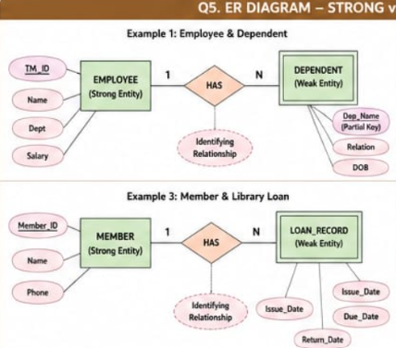
Strong Entity
Definition
A Strong Entity is an entity that can exist independently.
It has its own Primary Key.
It does not depend on any other entity for identification.
Each record is uniquely identified using its primary key.
Weak Entity
Definition
A Weak Entity is an entity that cannot exist independently.
It depends on a Strong Entity for its identification.
It does not have a complete primary key.
It is represented by a double rectangle in an ER diagram.

Slide 20
Comparison Between Strong and Weak Entities
Strong Entity | Weak Entity
Exists independently | Depends on a Strong Entity
Has its own Primary Key | Uses a Partial Key
Can exist without another entity | Cannot exist without its owner
Represented by a single rectangle | Represented by a double rectangle
Identification is independent | Identification depends on the Strong Entity
Example: Student, Book | Example: Dependent, Order Item

Slide 21
Conclusion
Strong and Weak Entities are fundamental concepts in ER modeling.
A Strong Entity has an independent existence and its own primary key.
A Weak Entity depends on a Strong Entity and uses a partial key for identification.
Understanding these concepts helps in designing reliable and efficient databases.

Slide 22
THANK YOU

